Slide 1
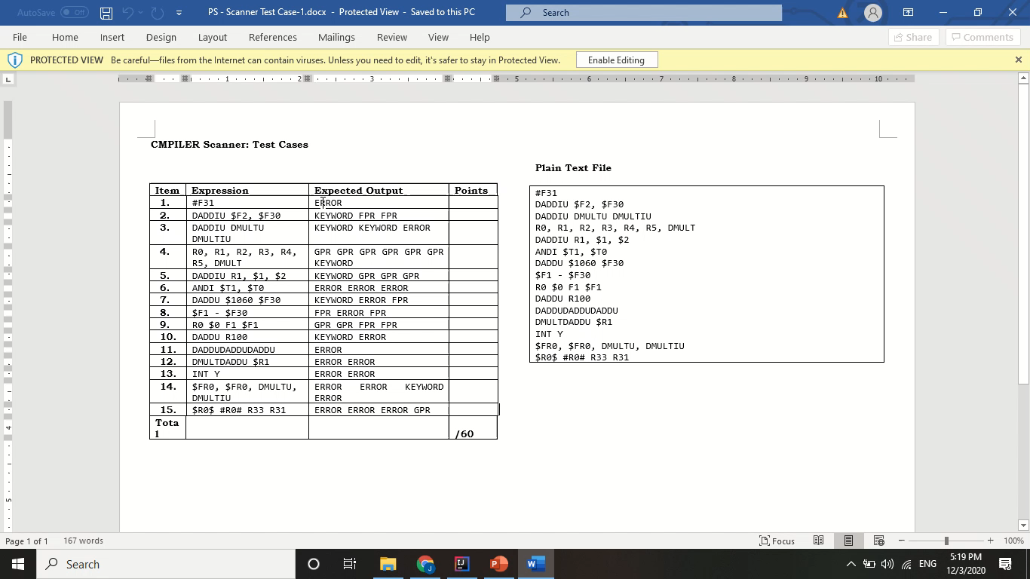
Ang, Jerald Edric D. S12
Video Presentation

Slide 2
Reading the text input
How do you create tokens?
The entire input text is saved as a StringBuilder, and later split according to the listed delimiters. Each string segment (named as word in the code) is then converted into their own tokens.
The class Token has two attributes: TokenType and lexeme. The TokenType pertains to the token label (i.e. GPR, FPR, KEYWORD, ERROR) and the lexeme is simply the word itself.
The function identifyToken allows the class to label the word to its correct TokenType. It is in this function that the DFA is implemented.
Input: String lexeme (original word)
If the string is empty, this will be ignored and not made into a Token
Process: check the input per character, match each entry to the DFA and return the state it last stayed on
Output: TokenType
After creating the Token, it is then stored to the tokenList, which makes it easier to access. The file is written during the tokenization process.

Slide 3
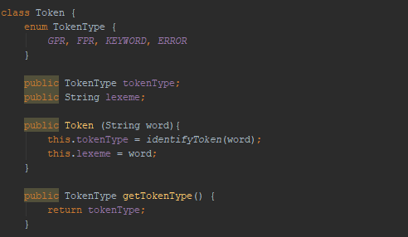
code snippets: Token class

Slide 4
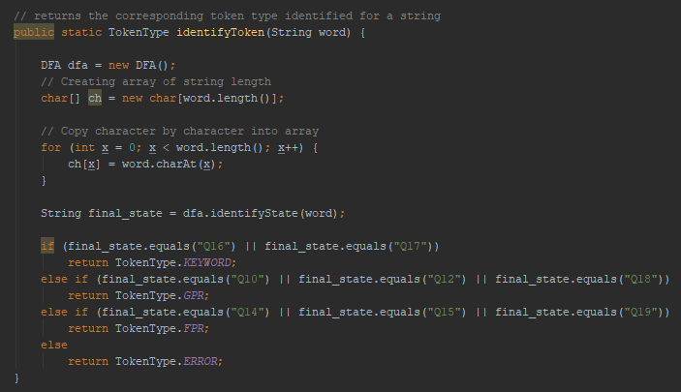
code snippets: Token class
{
Match final states of DFA

Slide 5
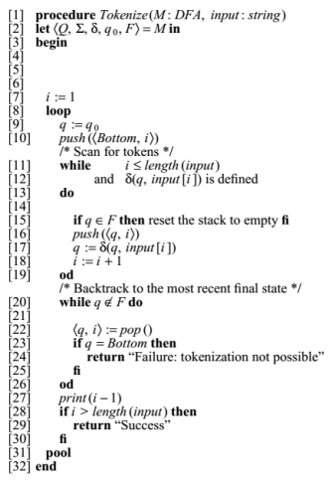
implementation of maximal munch algorithm
The maximal munch algorithm was applied by using the pseudocode provided. Modifications were done to suite the code structure, such as removing the ‘loop’ as it only traverses once, and returning the states rather than accept / reject.
This is especially useful for the case of the ‘$’ input, as it can be either a GPR or an FPR depending on the preceding characters. It takes the longest possible input before a delimiter in determining the TokenType. Other cases that utilize this algorithm are in DADDU, DADD and DADDUDADDU , R3, R30 and R300 and so on.

Slide 6
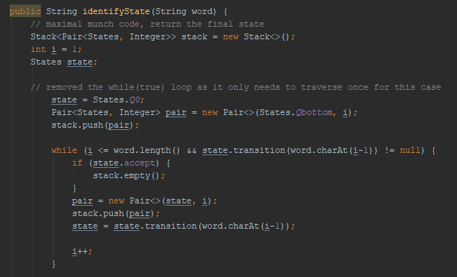
code snippets: maximal munch algorithm

Slide 7
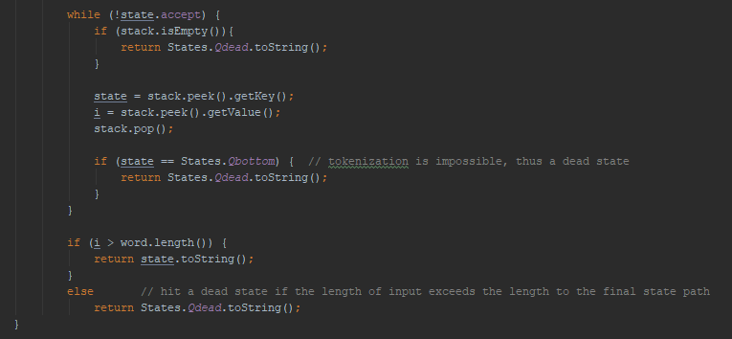
code snippets: maximal munch algorithm

Slide 8
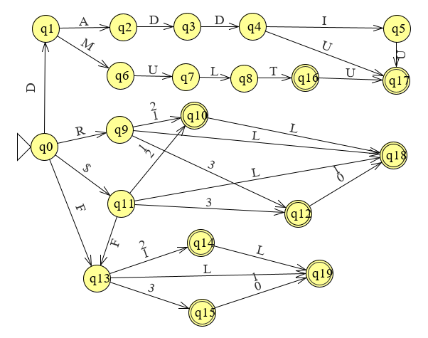

DFA implementation
The program checks first for the keywords, then proceeds to check the GPR and FPR format. The paths for GPR and FPR are interconnected given that they both can have the symbol ‘$’.
L = [0-9]

Slide 9
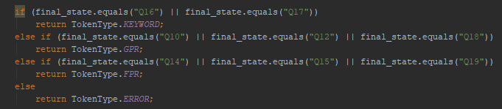
Unrecognizable Tokens
The program first checks whether a word fits the description of a KEYWORD, GPR, or FPR. If it is neither of the 3, it then automatically assumes this as an ERROR.
Given the maximal munch algorithm, if the state returned is not one of the final states, then it was not able to proceed to the next state and got stuck in a non-final state. If the input is not part of the alphabet, it goes to a Qdead state.

Slide 10
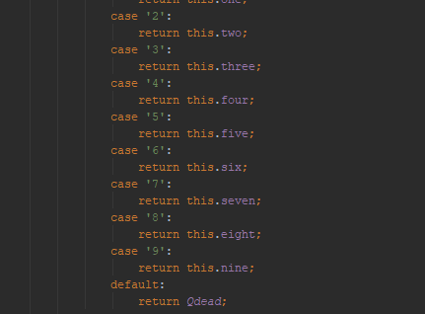
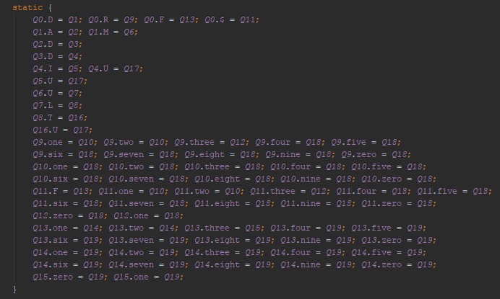
code snippet: unrecognizable tokens
Possible transitions are defined. A null transition indicates the process getting “stuck”.
Qdead state

